Slide 1
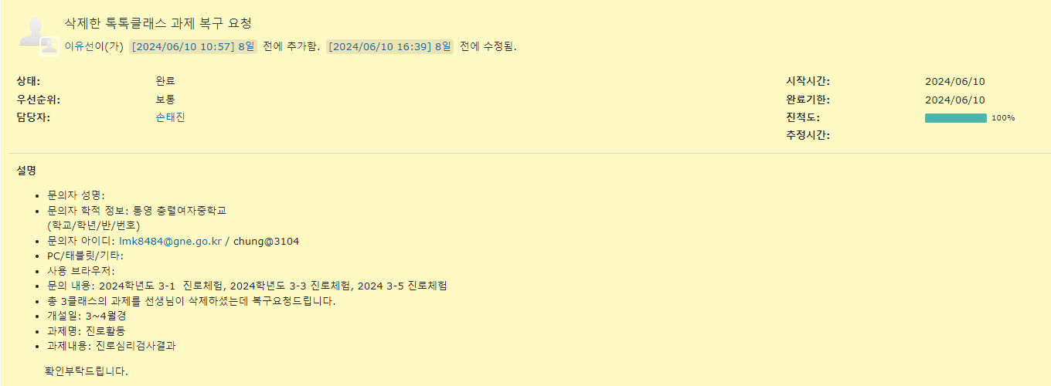

Slide 2
INSERT INTO lettnemplyrinfo (
EMPLYR_ID
, ORGNZT_ID
, USER_NM
, PASSWORD
, GROUP_ID
, PSTINST_CODE
, EMPLYR_STTUS_CODE
, ESNTL_ID
, PASSWORD_HINT
, PASSWORD_CNSR
) SELECT
'user1'
, ORGNZT_ID
, '사용자1'
, PASSWORD
, GROUP_ID
, PSTINST_CODE
, EMPLYR_STTUS_CODE
, 'USRCNFRM_00000000001'
, '비밀번호 힌트'
, '비밀번호 답'
FROM lettnemplyrinfo
WHERE EMPLYR_ID = 'admin'
INSERT INTO lettnemplyrinfo (
EMPLYR_ID
, ORGNZT_ID
, USER_NM
, PASSWORD
, GROUP_ID
, PSTINST_CODE
, EMPLYR_STTUS_CODE
, ESNTL_ID
, PASSWORD_HINT
, PASSWORD_CNSR
) SELECT
'user2'
, ORGNZT_ID
, '사용자2'
, PASSWORD
, GROUP_ID
, PSTINST_CODE
, EMPLYR_STTUS_CODE
, 'USRCNFRM_00000000002'
, '비밀번호 힌트'
, '비밀번호 답'
FROM lettnemplyrinfo
WHERE EMPLYR_ID = 'admin'

Slide 3
* 첨부파일 작업 시 진행
globals.properties
# file경로
Globals.File = D:/JAVA_PROJECTS/kopo/2023/homepage/workspace/.metadata/.plugins/org.eclipse.wst.server.core/tmp0/wtpwebapps/homepage2023
context-properties.xml
<entry key="board.fileStorePath" value="${Globals.File}/upload/board/"/>
* 밑에 부분은 썸네일 작업 시 진행
<entry key="photoThumbWidth" value="200"/>
<entry key="photoThumbHeight" value="140"/>

Slide 4
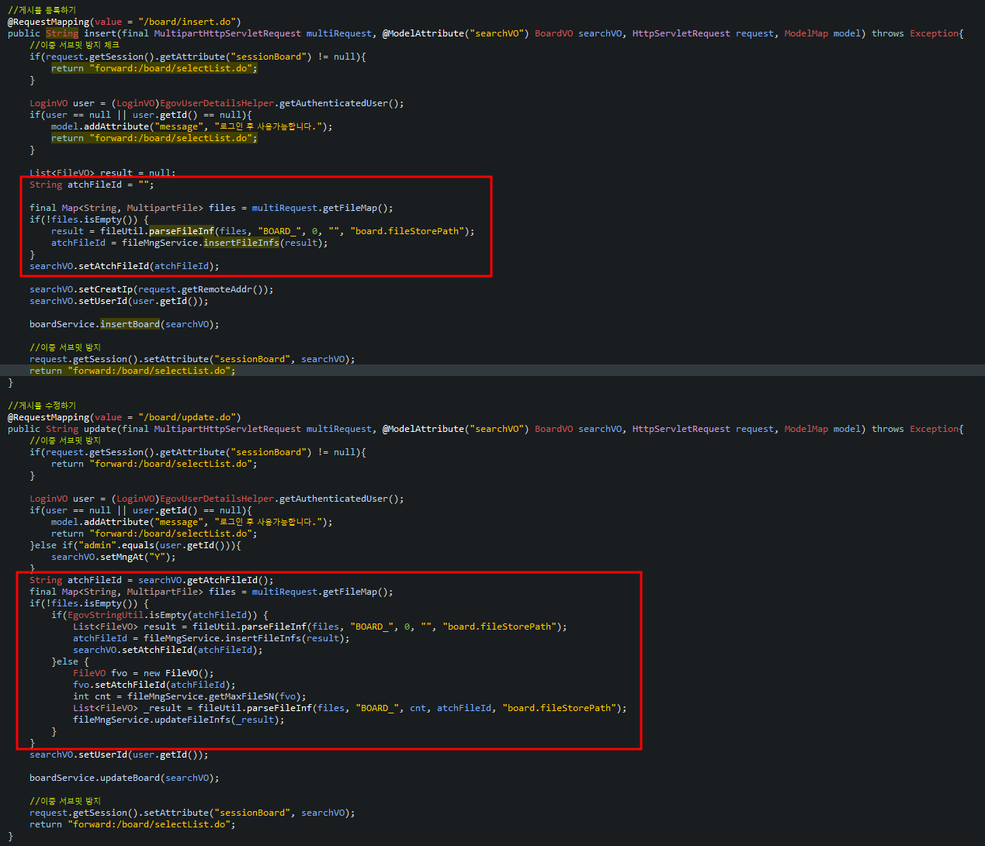


BoardController 2
* 첨부파일 작업 시 진행
BoardRegist
BoardController 1

